Slide 1













LOCAL STORAGE & MOBILE PREFERENCES
Shreya Singh, Shreya Mete, Shubhra

Slide 2

OUR TEAM
Shubhra
Shreya
Singh Senger
Shreya
Mete

Slide 3



Local & Remote Data
Data Persistence
OVERVIEW
Shared Preferences for Preferences
Application Settings

Slide 4
LOCAL DATA
Local data is the information that an application stores directly on your device, such as your mobile phone, laptop, or computer, instead of storing it on an online server.
  For example, imagine you download a shopping app on your phone. You open the app and change its theme from light mode to dark mode.
When you close and reopen the app, it still opens in dark mode. Why?
Because the app has saved your dark-mode preference locally on your phone. It doesn't need to ask an online server every time you open the app.

Slide 5
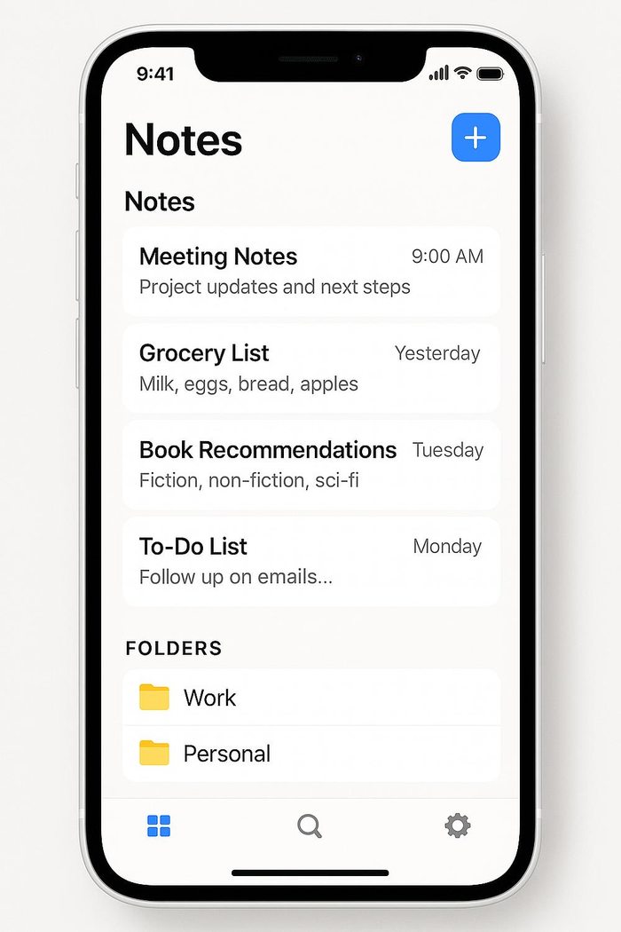
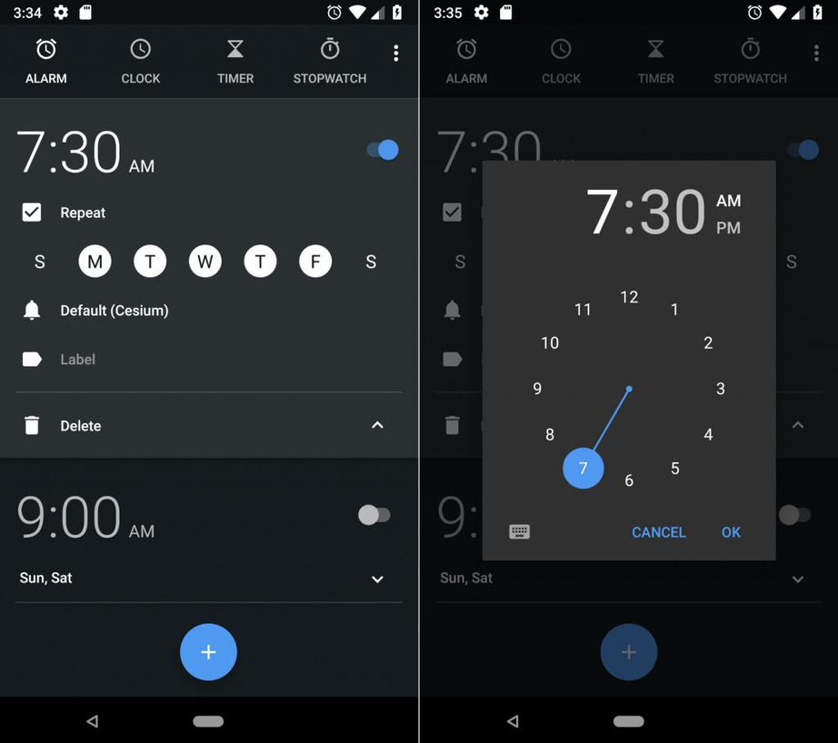
LOCAL DATA
When you write a note and save it on your phone, it can be stored locally and accessed later, even without internet.
When you set an alarm for 7 AM, your phone remembers that alarm locally.

Slide 6
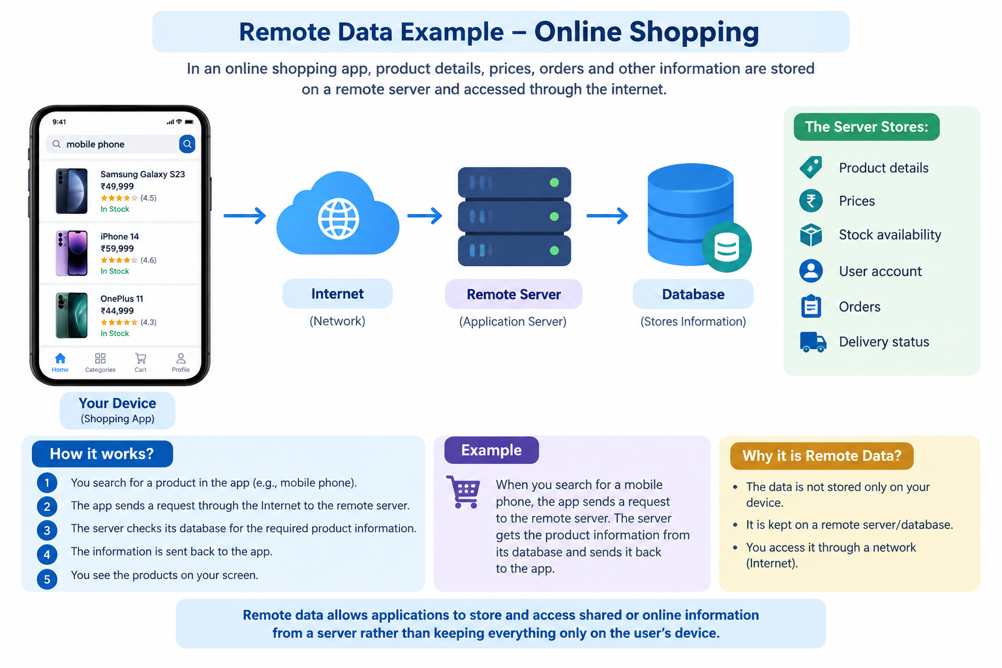
REMOTE DATA
Remote data is information that is stored somewhere outside your device, usually on a remote server or cloud, and accessed through a network such as the internet.

Slide 7
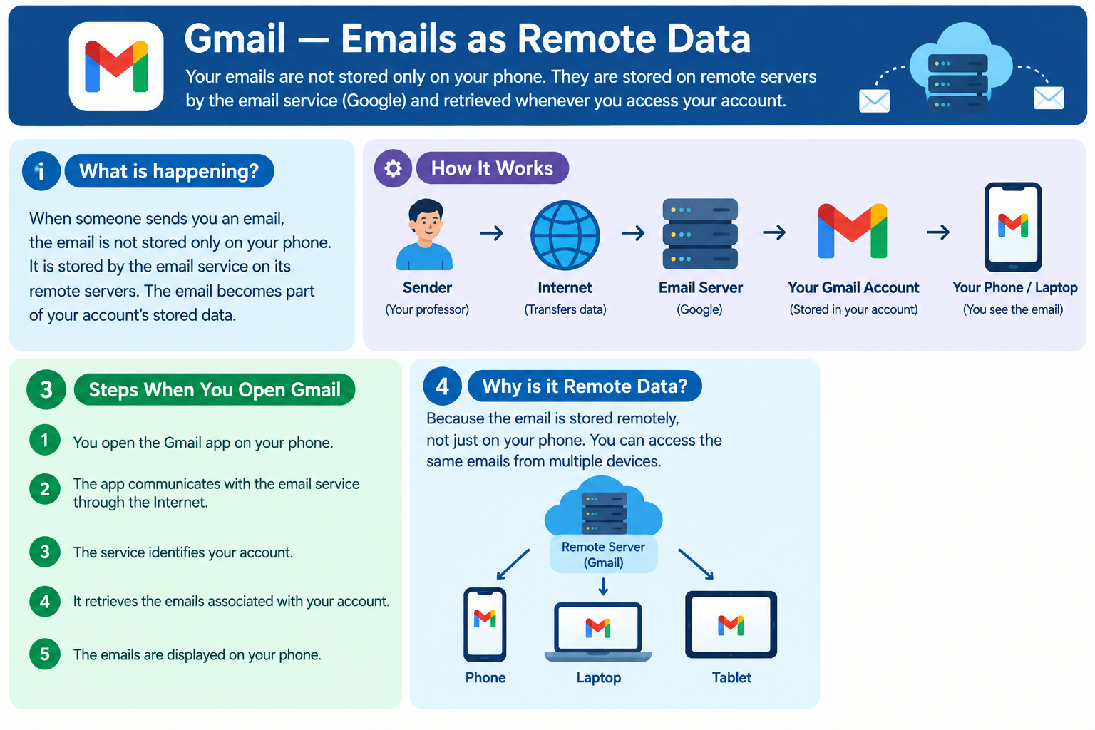
REMOTE DATA
Suppose my friend sends me an email.
I can open that email on my phone today,
and later I can log into the same account on
my laptop and see the same email.
This is possible because the email is stored
remotely and my devices retrieve it from
the email service.

Slide 8
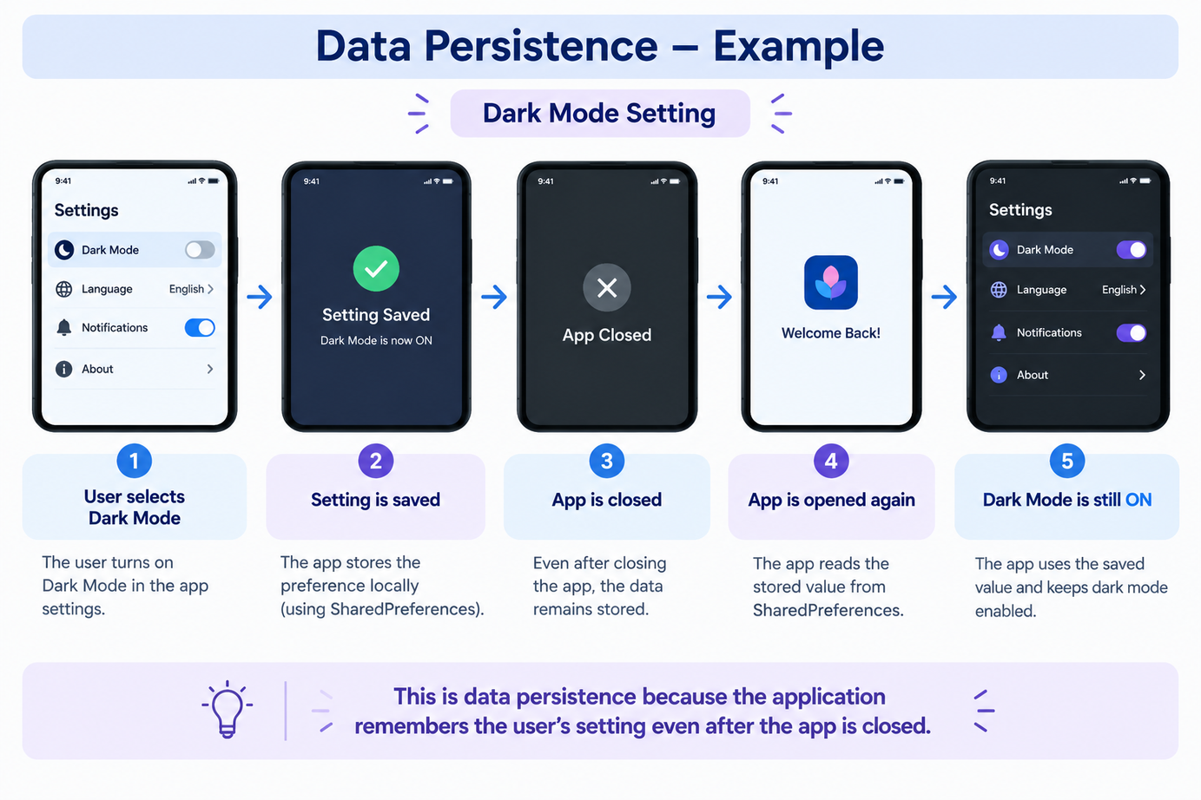
DATA PERSISTENCE
Data persistence means that data remains stored and available even after an application is closed, restarted, or sometimes even after the device is restarted.
Persistence = Data is remembered.

Slide 9
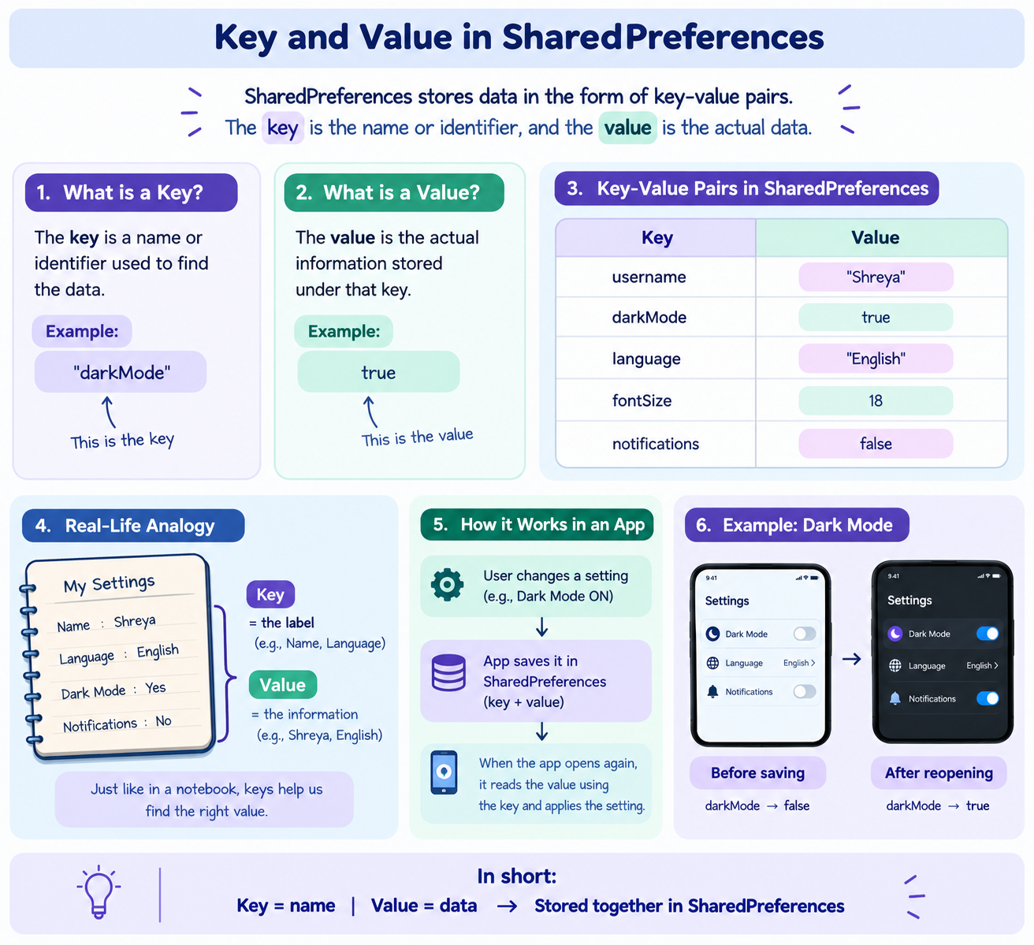
SHAREDPREFERENCES FOR PREFERENCES
  SharedPreferences is a simple way in Android to store small pieces of data locally on the user's device in the form of key-value pairs.
  A small storage area inside the app for remembering simple settings.
  SharedPreferences is designed for simple data types suchas string, boolean, integer
  We Don't use SharedPreferences for Large databases

Slide 10
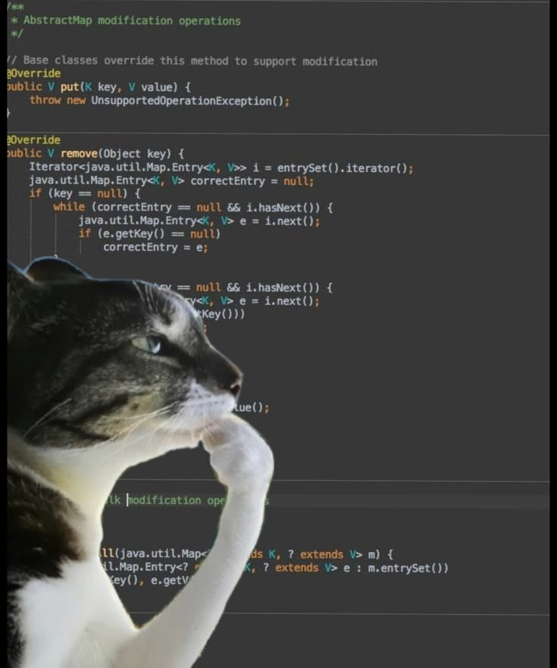
CODE
TIMEE
Your paragraph text

Slide 11
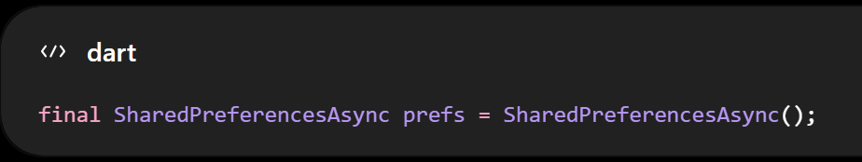

SHAREDPREFERENCES FOR PREFERENCES
This creates our SharedPreferences object.
We use this object to save and retrieve data
These three lines are used to save the user's settings in SharedPreferences. The first line stores the user's name using username as the key, the second stores whether Dark Mode is true or false using darkMode, and the third stores the selected language using language. The await ensures that the app waits for the data to be saved before continuing.

Slide 12
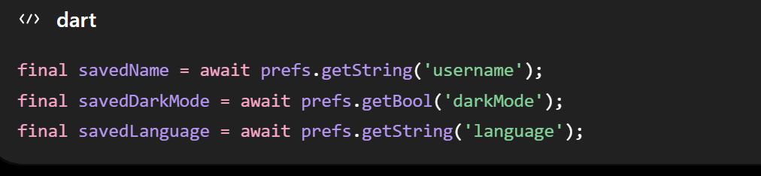
SHAREDPREFERENCES FOR PREFERENCES
READ AND RETRIVE THE DATA
These three lines are used to retrieve the data that was previously saved in SharedPreferences. getString('username') gets the saved username, getBool('darkMode') gets whether Dark Mode was saved as true or false, and getString('language') gets the saved language. The retrieved values are stored in savedName, savedDarkMode, and savedLanguage, so the app can use them when it opens again.

Slide 13
Local Database
SQLite and Hive
OVERVIEW
Local Caching
Offline First Architecture

Slide 14

WHAT IS LOCAL DATABASE?
A local database is a structured storage system that keeps application data directly on the user's device. Unlike simple preference storage, databases are designed to handle larger amounts of structured data and support operations such as querying, updating, and deleting records
WHY LOCAL STORAGE?
  Applications need to store hundreds of records
  Multiple fields and relationships of data
  To search, filter, sort, update, and delete records
  To remain data available even without network connectivity
  Local databases can also be used to cache API data
SQLite | Hive
Relational database | NoSQL / key-value style database
Uses tables and SQL | Simple and lightweight
Suitable for structured and relational data | Convenient for local objects and simpler data structures

Slide 15
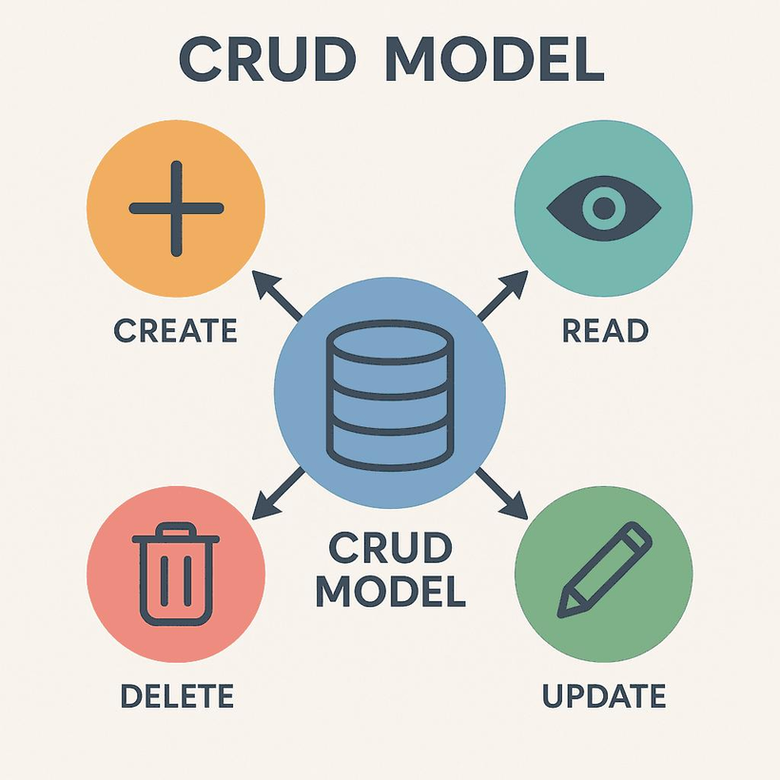


DATABASE OPERATIONS & CRUD
CREATE
Add a new record to
the database.
READ
Retrieve existing
records.
Eg: create a note study flutter
Eg: view all notes:
UPDATE
Modify an existing
record.
DELETE
Remove a record.
Eg: update “study flutter” to “flutter +Sqlite”
Eg: delete “study flutter”

Slide 16
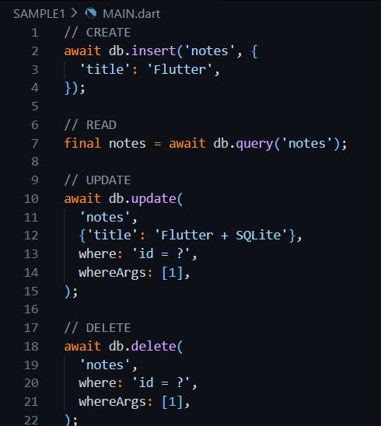

CODE FOR CRUD

Slide 17
SQLITE- RELATIONAL LOCAL DATABASE
Key characteristics
  Data is organized into tables
  Tables contain rows and columns
  Each record can have a primary key
  Supports SQL for querying and manipulating data
  Supports relationships between structured data
  Works completely offline on the device
  Suitable for applications requiring complex queries
SQLite in flutter:
sqflite (commonly used flutter package)
It allows Flutter applications to:
  Open/create databases
  Create tables
  Insert records
  Query records
  Update records
  Delete records

Slide 18
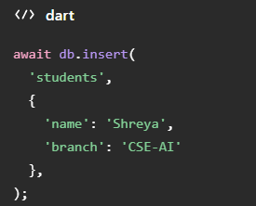
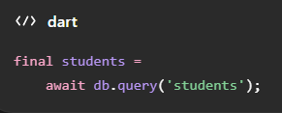
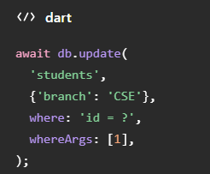
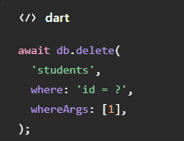
SQLITE IN FLUTTER
CREATE
READ
UPDATE
DELETE

Slide 19
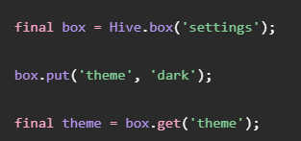
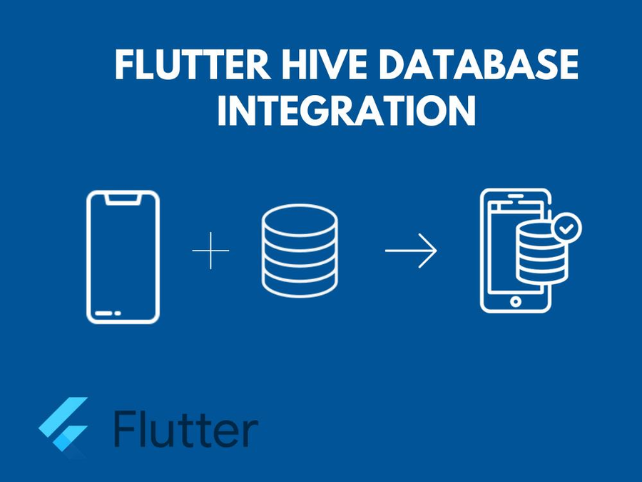
HIVE
Instead of thinking primarily in terms of tables and SQL, we can think of Hive as a NoSQL or key-value style local database.
WHY USE HIVE?
1.HIVE IS ATTRACTIVE WHEN WE WANT SOMETHING SIMPLE AND LIGHTWEIGHT
2.WE DON'T NEED TO WRITE SQL QUERIES.
3.THE API IS RELATIVELY SIMPLE.
4.IT'S ALSO USEFUL FOR STORING LOCAL OBJECTS AND CACHED DATA.

Slide 20
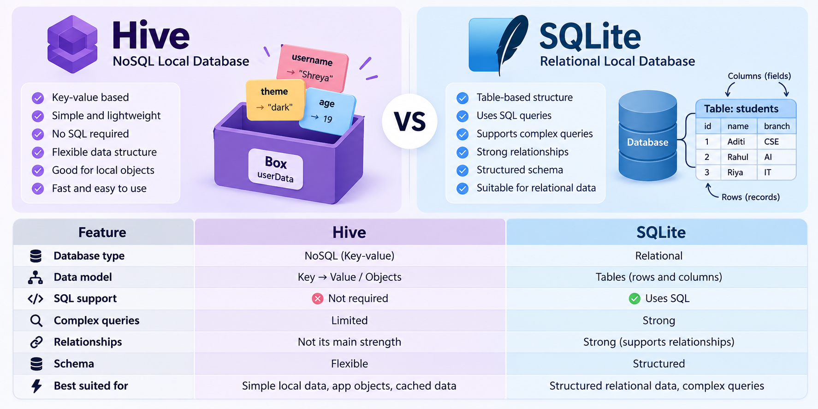
SQLITE V/S HIVE

Slide 21
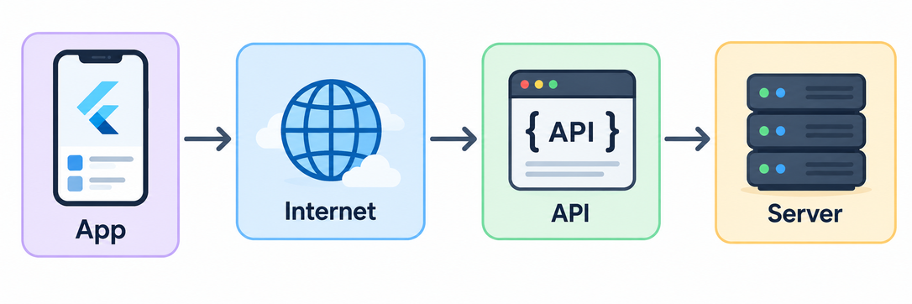
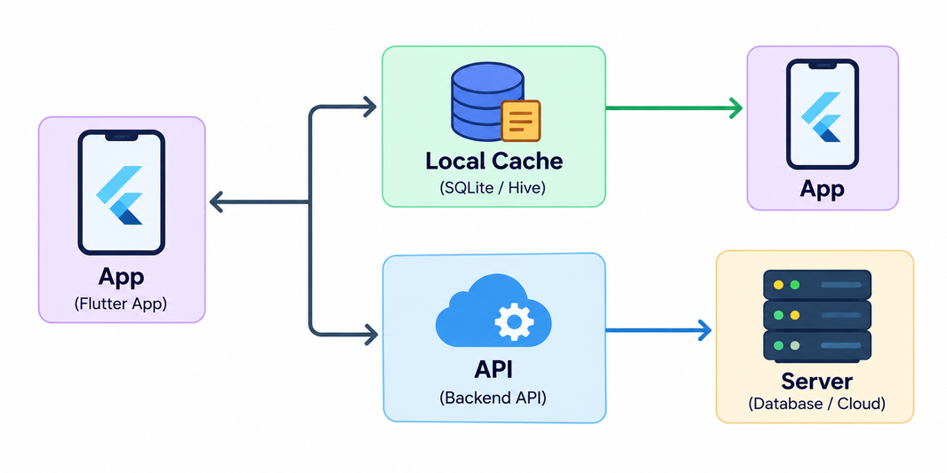
LOCAL CACHING
Caching is the process of storing a local copy of data that originally came from another source, usually an API, so that it can be accessed faster or when the network is unavailable.
without caching:
with caching:

Slide 22
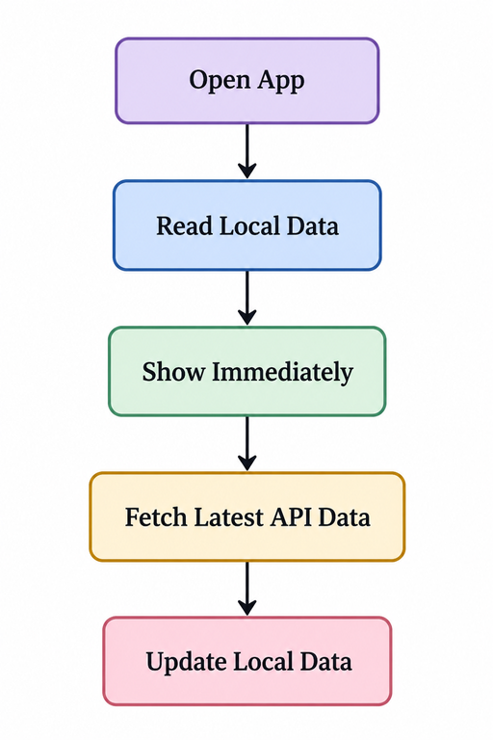
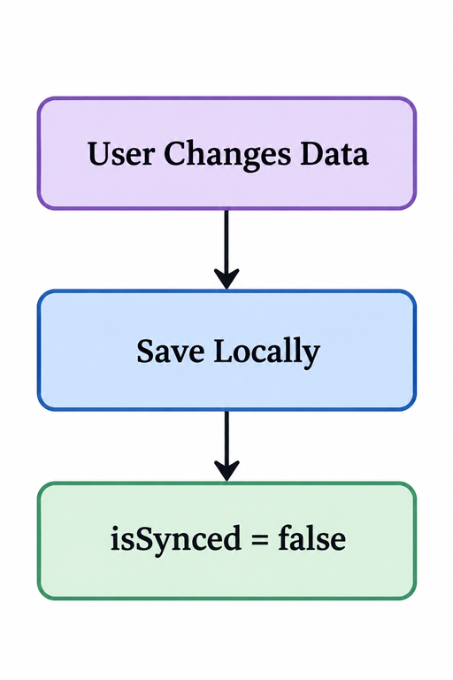
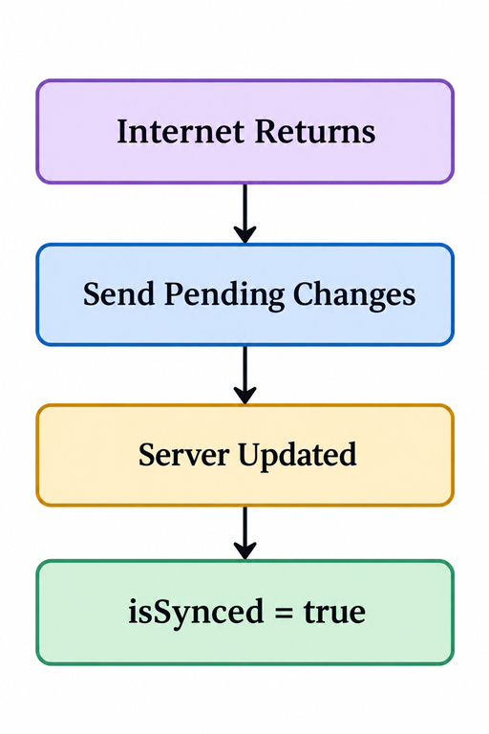


OFFLINE-FIRST APLLICATIONS
An offline-first application is designed so that core functionality can continue even when network connectivity is unavailable or unreliable.
READ
WRITE
SYNCHRONIZE

Slide 23


Slide 24




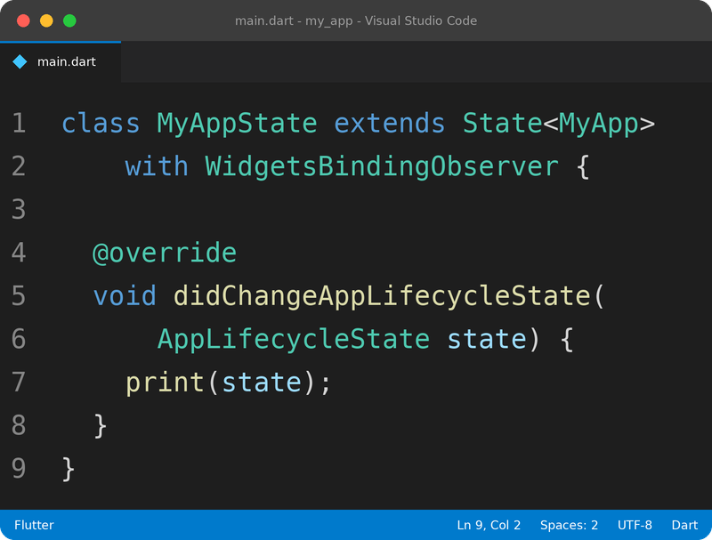



APPLICATION LIFECYCLE
The application lifecycle describes the different states of an app while the user opens, uses, leaves, and returns to it.
MAIN STATES
Resumed
→ App is visible and the user can interact with it.
Inactive
→ App is temporarily not receiving user input.
Paused
→ App is running in the background.

Slide 25


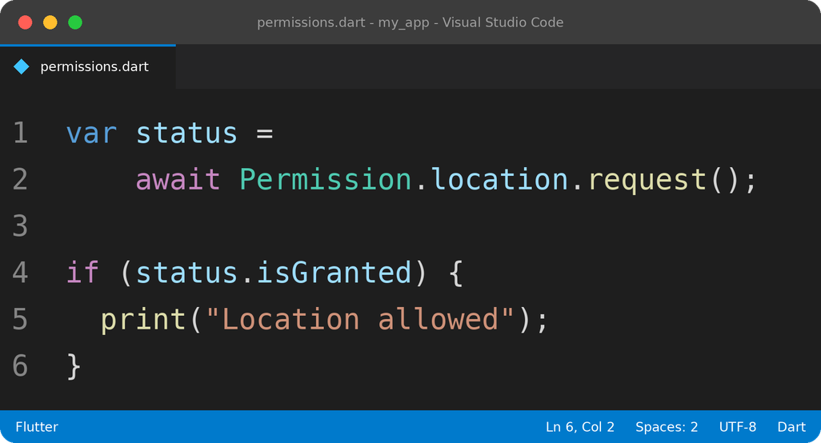
PERMISSIONS
Permissions are the user's approval for an app to access certain features of the phone.
Common examples
Flutter Code
📷 Camera
📍 Location
🎤 Microphone
🖼️ Photos
🔵 Bluetooth
🔔 Notifications

Slide 26
NOTIFICATIONS
Notifications are messages shown by an app to inform or remind the user.
They can appear even when the user is not currently using the app.
Two common types
Local Notification
Push Notification
Created by the app/device.
Sent from the app's server.
Flutter
Flutter
For local notifications, a commonly used package is:
For push notifications:
flutter_local_notifications
Firebase Cloud Messaging (FCM)

Slide 27

LIFECYCLE + PERMISSIONS + NOTIFICATIONS
Now connect the three concepts using one real app.
Example — To-Do App
USER OPENS APP
App is RESUMED
User creates task
Notification permission requested
ALLOW ✓
App is RESUMED
User opens the app
🔔 Notification
Reminder time arrives
App goes to BACKGROUND
Lifecycle
Permissions
Notifications

Slide 28
SYNCHRONIZING LOCAL & REMOTE APPLICATION DATA
LOCAL DATA & REMOTE DATA
Where does an app store data?
An application can work with two types of data:
Local Data
Remote Data
Data stored on the user's device.
Data stored on a server and accessed through the internet.
Examples:
Examples:
  Tasks
  Notes
  App settings
  User preferences
  User account
  Online orders
  Messages
  Cloud data

Slide 29
SYNCHRONIZATION
Synchronization means keeping the local data and remote data updated with each other.
Suppose both contain:
When internet comes back
Now:
PHONE
SERVER
Phone
PHONE
SERVER
Task A
Task B
Task C
Task A
Task B
Task C
Task A
Task B
Task C
Task D
Task A
Task B
Task C
Task D
Internet
Send Task D
Server
✓ Updated

Slide 30
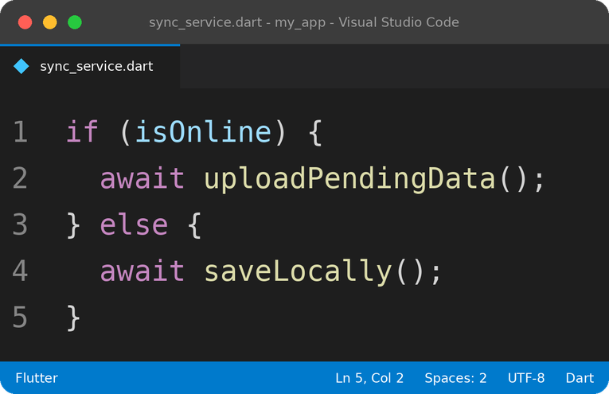
HOW SYNCHRONIZATION WORKS
Basic Synchronization Flow
USER CHANGES DATA
SAVE DATA LOCALLY
INTERNET
AVAILABLE?
NO
YES
Keep it locally
Send to API
Mark as pending
Server
Wait for internet
Updated
✓ SYNCED

Slide 31
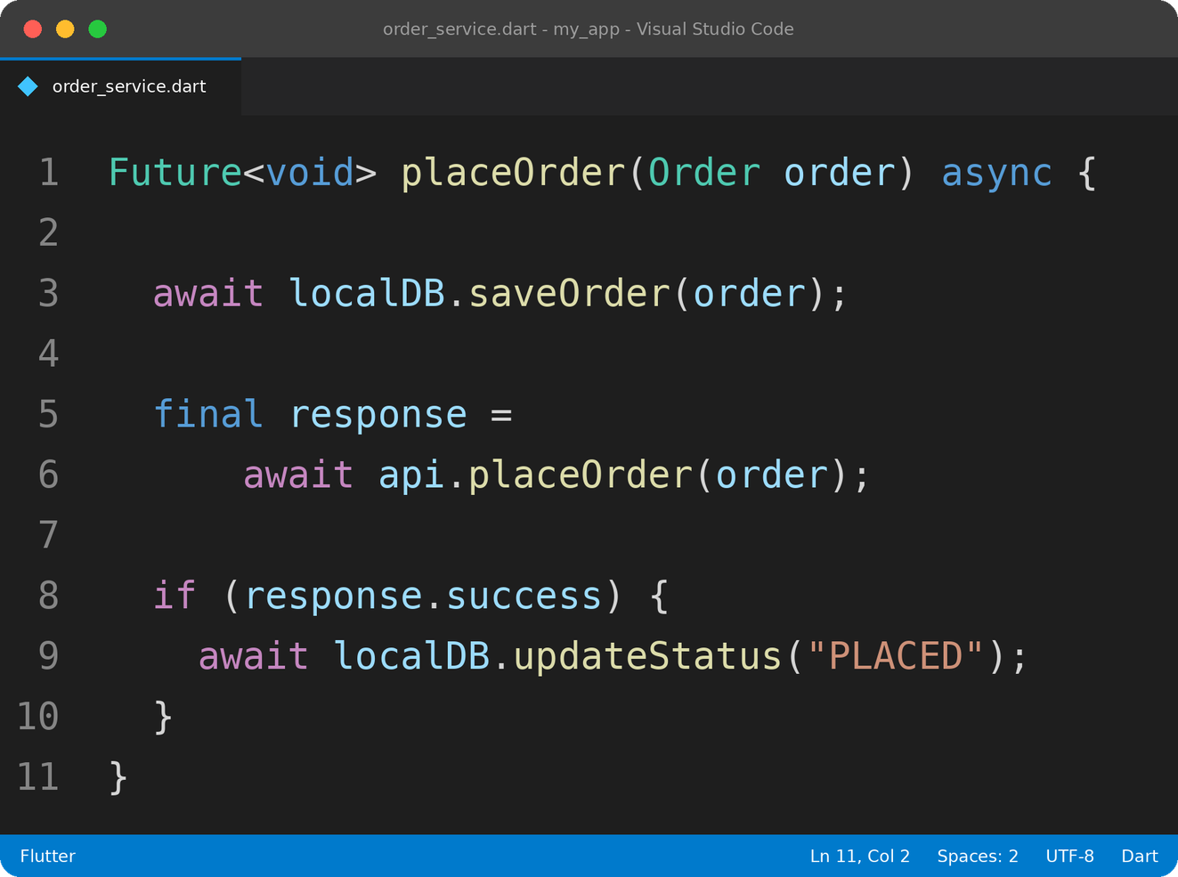
EXAMPLE — PLACE ORDER
1. User taps "Place Order"
2. Flutter creates Order object
3. Save order locally
4. POST /orders → Backend API
5. Server stores order in database
6. Restaurant accepts order
7. Server changes status:
PLACED → CONFIRMED → PREPARING
8. App fetches/receives updated status
9. Flutter updates UI

Slide 32


THIS IS THE END OF OUR PRESENTATION, THANKYOU

